Slide 1
Computer Vision and Deep Learning
Lecture 9

Slide 2
Computer vision tasks

Slide 3
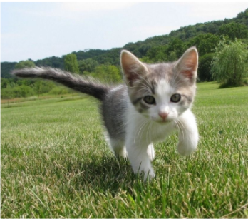
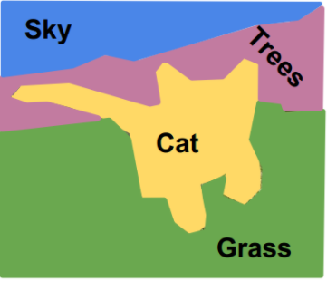
Computer vision tasks
Classification
What object is in this image?
CAT
Semantic segmentation
What label has each pixel?
Pixel level, we are not interested in objects
https://tariq-hasan.github.io/concepts/computer-vision-semantic-segmentation/

Slide 4
Computer vision tasks
Object localization
What object is in this image and where is it located?
CAT

Slide 5
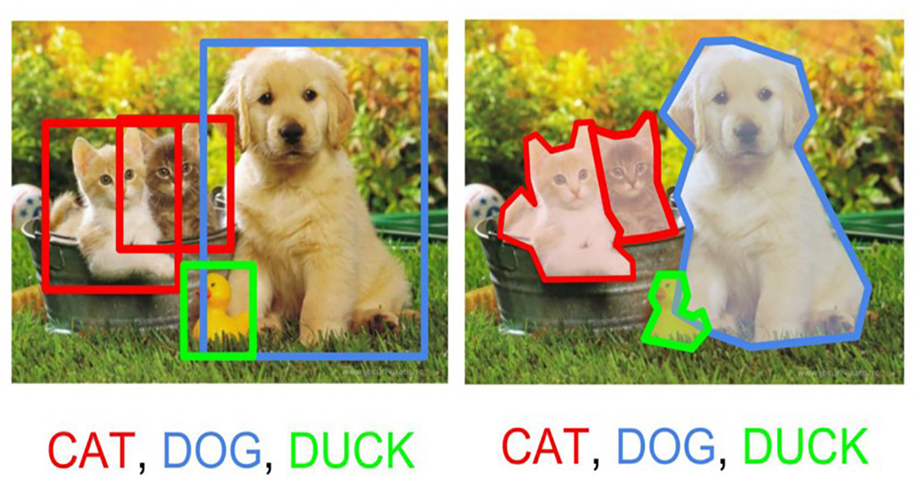
Computer vision tasks
Object detection: multiple objects
(the label and position - bounding box - of each object)
Instance segmentation: multiple objects
(the label and position of each object)
Image source: https://static.artfido.com/2018/05/cover-12.jpg

Slide 6
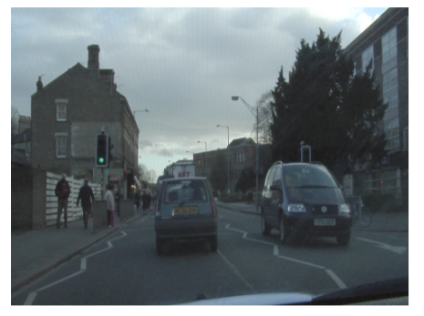
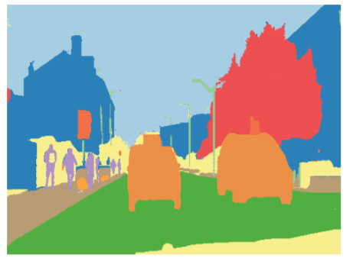
Semantic segmentation Examples
Autonomous driving

Slide 7

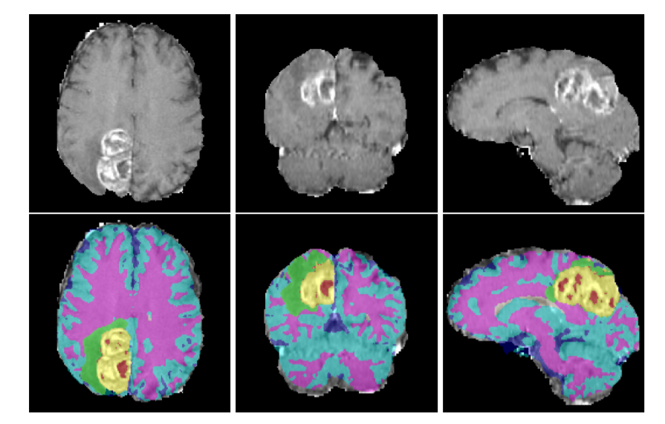
Semantic segmentation Examples
Medical image segmentation
https://arxiv.org/pdf/1810.05732.pdf
Real time hair colouring
https://news.developer.nvidia.com/3d-real-time-video-hair-coloration/

Slide 8
Semantic segmentation
Understating the image at pixel level: each pixel is labelled individually with a class
Groups both semantics and location
Global information: WHAT?
Local information: WHERE?

Slide 9

Semantic segmentation Naïve approach – sliding window
Image patch
CNN
CAT
Classify central pixel
Slide window over the input image and classify each image patch using a CNN
https://papers.nips.cc/paper/2012/file/459a4ddcb586f24efd9395aa7662bc7c-Paper.pdf

Slide 10
Semantic segmentation Naïve approach – sliding window
Image patch
CNN
CAT
Classify central pixel
Slide window over the input image and classify each image patch using a CNN
Highly inefficient!!

Slide 11
Let’s design a CNN to classify all pixels at once!
How would we encode the output (we need to output a class label for each pixel)?
What would be the input and the output size of this network?
Fully convolutional neural networks

Slide 12
Fully convolutional neural networks
The output should have the same spatial size as the input
H
FCN
H
C
W
W
Output depth:
Number of classes

Slide 13
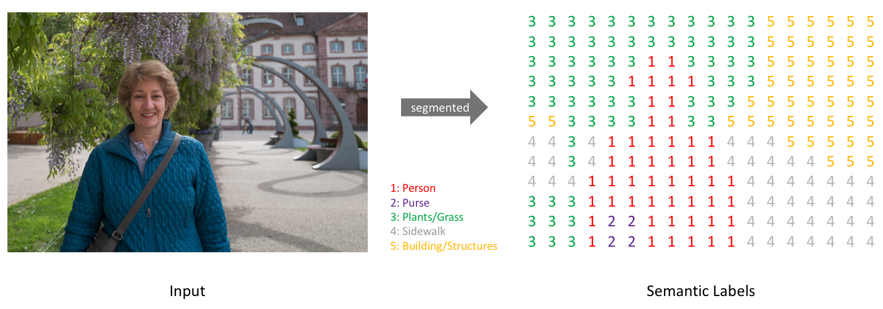
https://www.jeremyjordan.me/semantic-segmentation/#loss

Slide 14
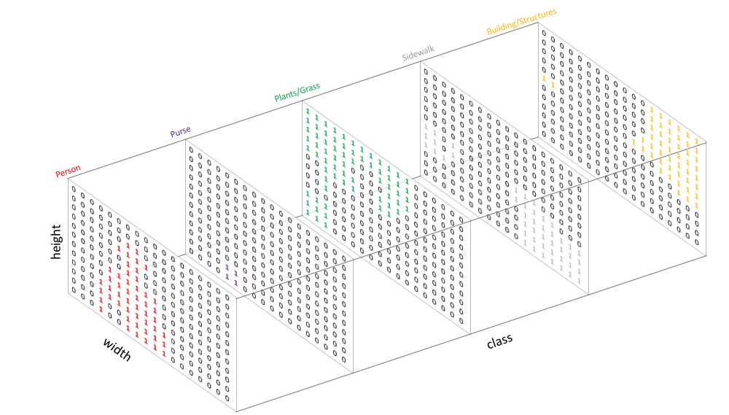

Slide 15
Output layer
Apply cross entropy pixel-wise on the last layer of the network
0 | 0
0 | 1
Class 0
2 | 1
1 | 0
0 | 1
1 | 0
Ground truth label image
Class 1
1 | 0
0 | 0
3 classes (0, 1, 2)
One hot encodings
2 – [0, 0, 1]
1 – [0, 1, 0]
0 – [1, 0, 0]
Class 2

Slide 16
Fully convolutional neural networks (FCN)
How to preserve the spatial size of the output map (input size must be equal to the output size)?

Slide 17
Fully convolutional neural networks
How to preserve the spatial size of the output map (input size must be equal to the output size)?
Don’t use any layers that reduce the spatial size

Slide 18
Fully convolutional neural networks
How to preserve the spatial size of the output map (input size must be equal to the output size)?
Don’t use any layers that reduce the spatial size -> inefficient
Use two paths in the network: a down-sampling and an up-sampling path

Slide 19
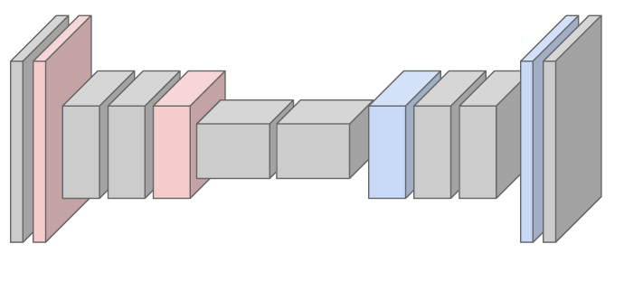
Fully convolutional neural networks
Down-sampling: strided convolutions, pooling layers
Down sampling layers
Up-sampling layers
Up-sampling: NN, bilinear interpolation, max unpooling, transposed convolution

Slide 20
Up-sampling techniques

Slide 21
Up-sampling Nearest neighbour
4 | 4 | 5 | 5
4 | 4 | 5 | 5
10 | 10 | 20 | 20
10 | 10 | 20 | 20
4 | 5
10 | 20
2x2
4x4

Slide 22
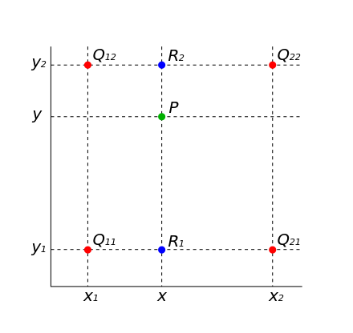
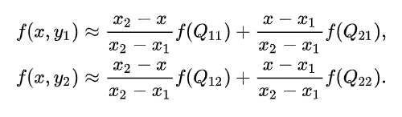
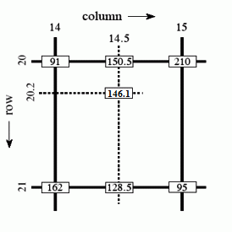
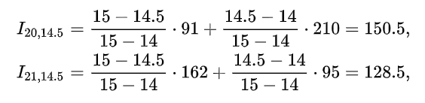
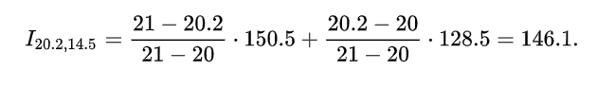
Up-sampling Bilinear interpolation

Slide 23
Up-sampling Bilinear interpolation
10 | 12.5 | 17.5 | 20
15 | 17.5 | 22.5 | 25
25 | 27.5 | 32.5 | 35
30 | 32.5 | 37.5 | 40
10 | 20
30 | 40
2x2
4x4

Slide 24
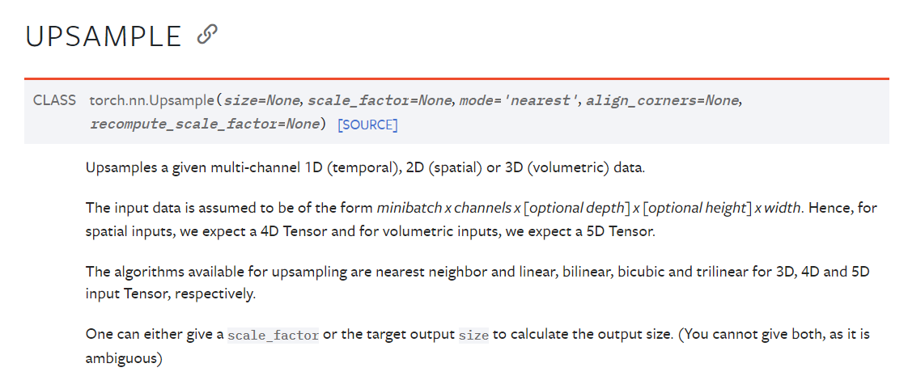
Up-sampling in torch
Interpolation:
- nearest
- bilinear
- bicubic
- trilinear

Slide 25
Max un-pooling
Symmetric structure of the FCN
1 | 4 | 3 | 1
2 | 3 | 5 | 2
10 | 9 | 2 | 3
7 | 3 | 4 | 20
0 | 4 | 0 | 0
0 | 0 | 5 | 0
10 | 0 | 0 | 0
0 | 0 | 0 | 20
4 | 5
10 | 20
……
Pooling: remember the position of the maximum element within the receptive field of the layer
Max Un-Pooling: use the position of the max
DOWNSAMPLING PATH
UP-SAMPLING PATH

Slide 26
Transposed convolutions Learnable up-sampling
Remember strided convolutions
3x3, stride 2, pad 1

Slide 27
Transposed convolutions Learnable up-sampling
Remember strided convolutions
3x3, stride 2, pad 1

Slide 28
Transposed convolutions Learnable up-sampling
Remember strided convolutions
3x3, stride 2, pad 1

Slide 29
Transposed convolutions Learnable up-sampling
Remember strided convolutions
3x3, stride 2, pad 1

Slide 30
Transposed convolutions Learnable up-sampling
NOW: transposed convolutions
filter
i1
The input feature i1 is multiplied with the filter values
i1 is like a weight for the filter value.
Copy the “weighted” filter in the corresponding output
3x3, stride 2, pad 1

Slide 31
Transposed convolutions Learnable up-sampling
Where there is overlap, sum up the values
NOW: transposed convolutions
filter
 | i2
The input feature i2 is multiplied with the filter values
i2 is like a weight for the filter value.
Copy the “weighted” filter in the corresponding output
3x3, stride 2, pad 1

Slide 32
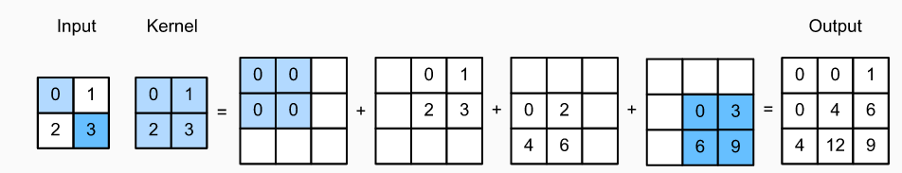
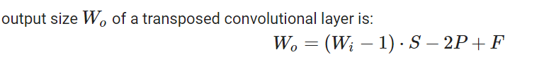
Transposed convolutions Learnable up-sampling
The weights of the filter are learned
At each position multiply the filter values with the corresponding position of the input layer to get the result of the output
Add overlapping positions
Example: 1 stride and 0 padding

Slide 33
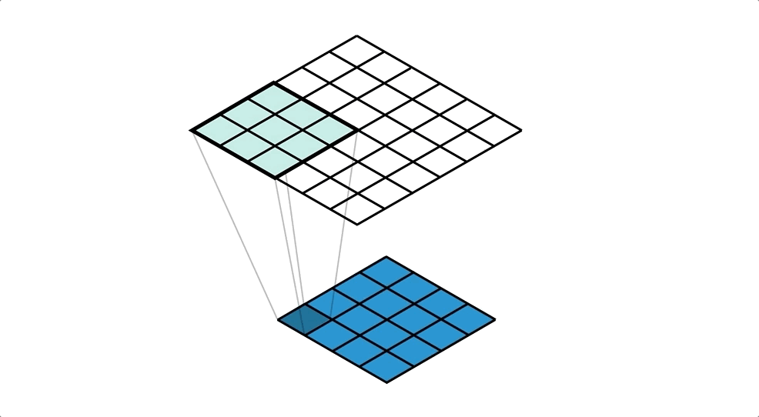
Transposed convolutions Learnable up-sampling
Image source: https://medium.com/apache-mxnet/transposed-convolutions-explained-with-ms-excel-52d13030c7e8

Slide 34
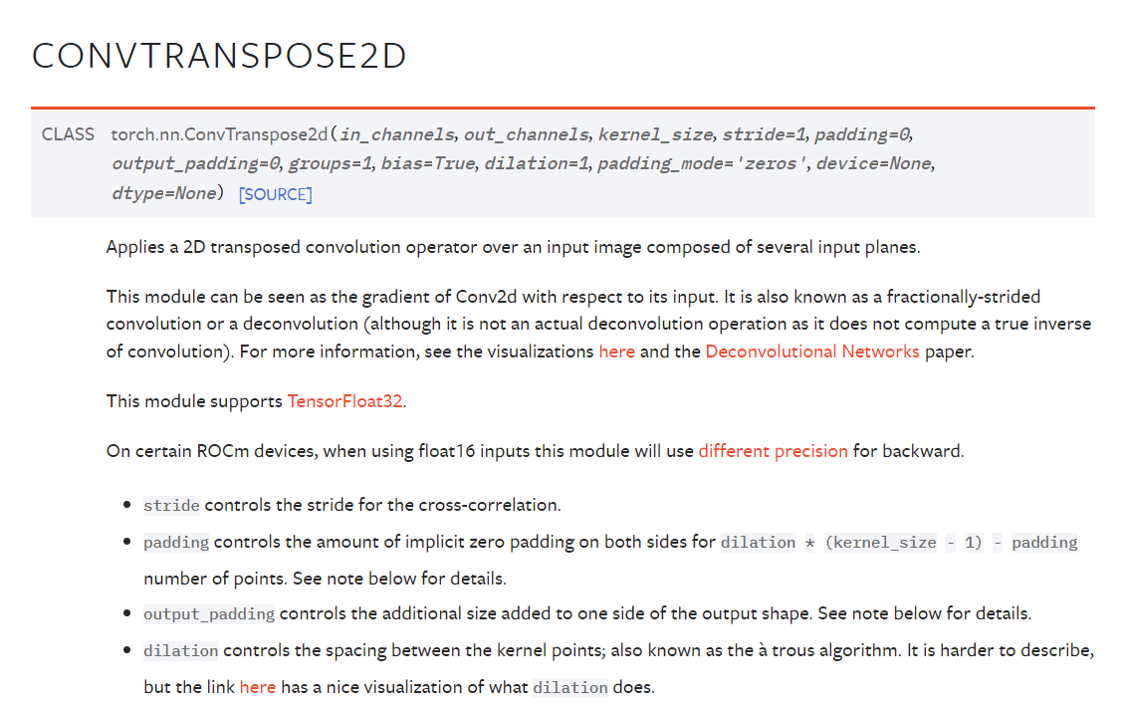
Transposed convolutions in torch

Slide 35
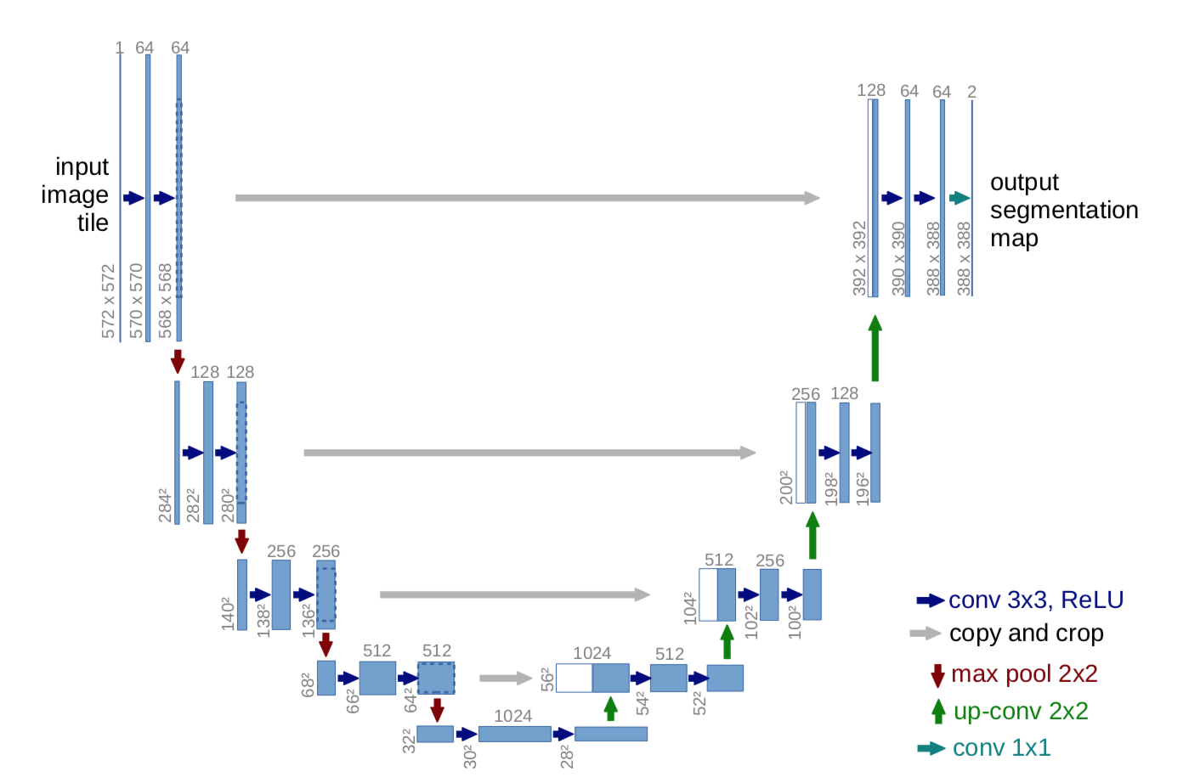
U-Net, 2015
Skip connections to help the upsampling path recover spatially detailed information from the downsampling path

Slide 36
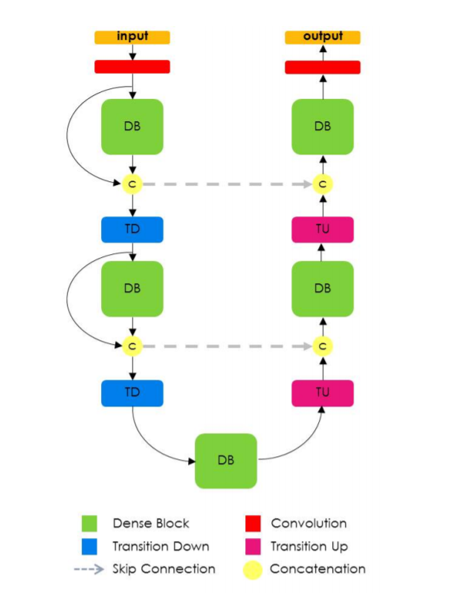
100 layers tiramisu, 2017
Similar to U-Net
uses Dense Block for convolutions and transposed convolutions
The one hundred layers tiramisu: Fully convolutional densenets for semantic segmentation, 2016

Slide 37
SegFormer
https://arxiv.org/pdf/2105.15203.pdf
https://github.com/ACSEkevin/An-Overview-of-Segformer-and-Details-Description

Slide 38
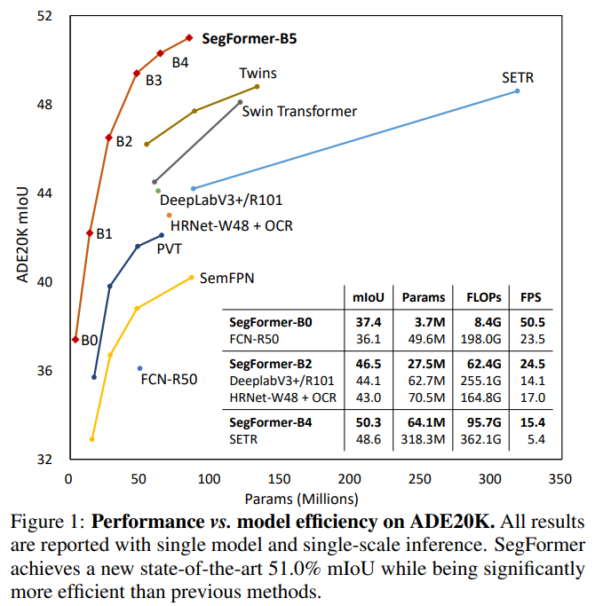
SegFormer
Transformer for semantic segmentation
positional-encoding-free
hierarchical encoder
all-MLP decoder design that yields a powerful representation

Slide 39
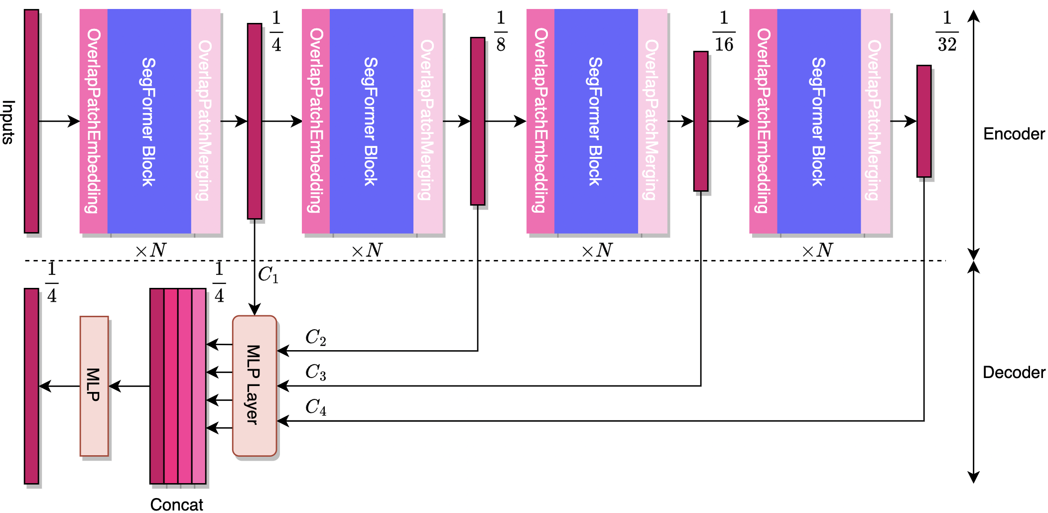
SegFormer
https://github.com/ACSEkevin/An-Overview-of-Segformer-and-Details-Description

Slide 40
SegFormer
Encoder: input image is scaled to its 1/32 size
Decoder: upsampled to 1/4 of the original size
https://github.com/ACSEkevin/An-Overview-of-Segformer-and-Details-Description

Slide 41
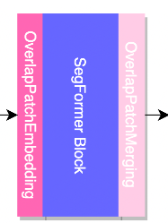
SegFormer Encoder
OverlapPatchEmbedding
- patch size > strides which leads to information sharing between patches thus called 'overlapped' patches.
x = Conv2D(n_filters, kernel_size=kernel_size, strides=strides, padding='same')(inputs)
batches, height, width, embed_dim = x.shape
x = tf.reshape(x, shape=[-1, height * width, embed_dim])
x = LayerNormalization()(x)
https://github.com/ACSEkevin/An-Overview-of-Segformer-and-Details-Description

Slide 42
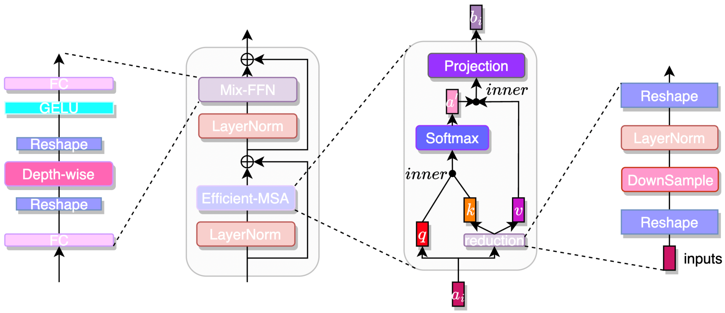
SegFormer Encoder
SegFormer Block
https://github.com/ACSEkevin/An-Overview-of-Segformer-and-Details-Description

Slide 43
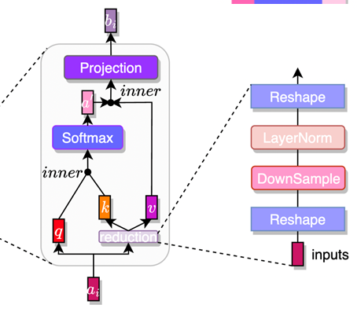
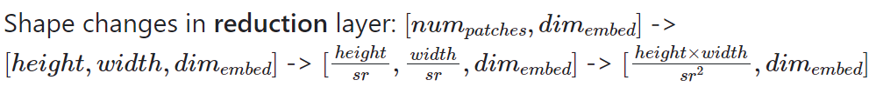
SegFormer Block
SegFormer Block – reduce the complexity of the attention mechanism
Key and value go through a reduction layer
batches, n_patches, channels = inputs.shape
if sr_ratio > 1:
inputs = tf.reshape(inputs, shape=[batches, height, width, embed_dim])
inputs = Conv2D(embed_dim, kernel_size=sr_ratio, strides=sr_ratio, padding='same')(inputs)
inputs = LayerNormalization()(inputs)
inputs = tf.reshape(inputs, shape=[batches, (height * width) // (sr_ratio ** 2), embed_dim])
https://github.com/ACSEkevin/An-Overview-of-Segformer-and-Details-Description

Slide 44
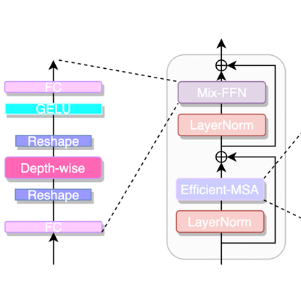
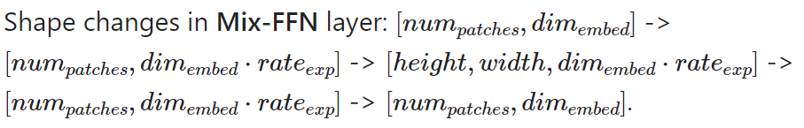
SegFormer Block
Mix FFN
- positional encoding(PE) are not necessary for segmentation tasks
- It allows the positional information to flow through the network
batches, n_patches, channels = inputs.shape
x = Dense(int(embed_dim * expansion_rate), use_bias=True)(inputs)
x = tf.reshape(x, shape=[batches, height, width, int(embed_dim * expansion_rate)])
x = DepthwiseConv2D(kernel_size=3, strides=1, padding='same')(x)
x = tf.reshape(x, shape=[batches, n_patches, int(embed_dim * expansion_rate)])
x = Activation('gelu')(x)
x = Dense(embed_dim, use_bias=True)(x
x = Dropout(rate=drop_rate)(x)
https://github.com/ACSEkevin/An-Overview-of-Segformer-and-Details-Description

Slide 45
SegFormer Block
OverlapPatchMerging: reconstruct sequences (patches) to feature maps
x = LayerNormalization()(x)
feature_Cx = tf.reshape(x, shape=[batches, height_Cx, width_Cx, embed_dims[index]])
stores the embedding dimension of each Segformer block
https://github.com/ACSEkevin/An-Overview-of-Segformer-and-Details-Description

Slide 46
SegFormer Encoder
SegFormer Block
https://github.com/ACSEkevin/An-Overview-of-Segformer-and-Details-Description

Slide 47
SegFormer
The feature map C1 goes through the MLP Layer without upsampling. Others are upsampled by ×2,×4,×8 respectively with bilinear interpolation
https://github.com/ACSEkevin/An-Overview-of-Segformer-and-Details-Description

Slide 48
Semantic segmentation metrics

Slide 49
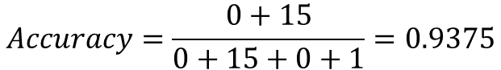
Semantic segmentation metrics
Pixel accuracy
Number of pixels classified correctly by the network
$$Accuracy=\frac{0+15}{0+15+0+1}=0.9375$$
Ground Truth
Prediction
https://ilmonteux.github.io/2019/05/10/segmentation-metrics.html

Slide 50
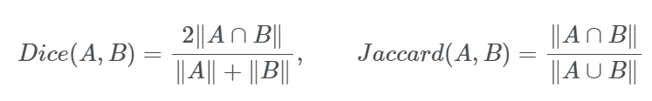
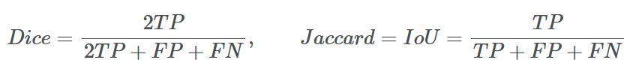
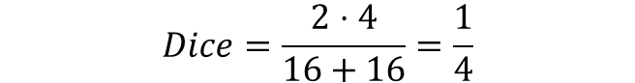
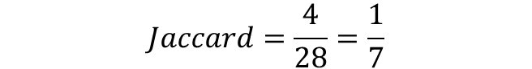
Semantic segmentation metrics
$$Dice=\frac{2⋅4}{16+16}=\frac{1}{4}$$
$$Jaccard=\frac{4}{28}=\frac{1}{7}$$
https://ilmonteux.github.io/2019/05/10/segmentation-metrics.html

Slide 51
Object localization
What object is this image and where is this object located in the image?
CAT

Slide 52
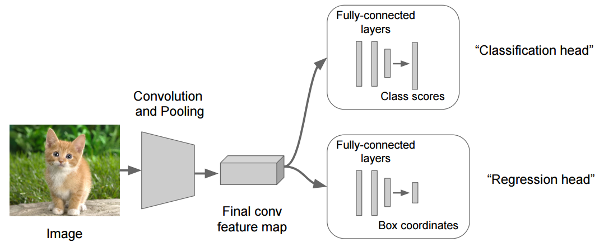
Object localization
Image source: https://leonardoaraujosantos.gitbook.io/artificial-inteligence/machine_learning/deep_learning/object_localization_and_detection

Slide 53
Object localization
C class scores
Softmax loss L_{s}
BBOX coordinates
4 outputs (x, y, w , h)
L2 loss L₂
Image source: https://leonardoaraujosantos.gitbook.io/artificial-inteligence/machine_learning/deep_learning/object_localization_and_detection

Slide 54
Object detection
Determine the class (label) and the position of EACH object in the input image
We can’t use the same approach as for localization
Each image would require a different number of outputs
Sliding window approach?

Slide 55
Proposal based object detection

Slide 56
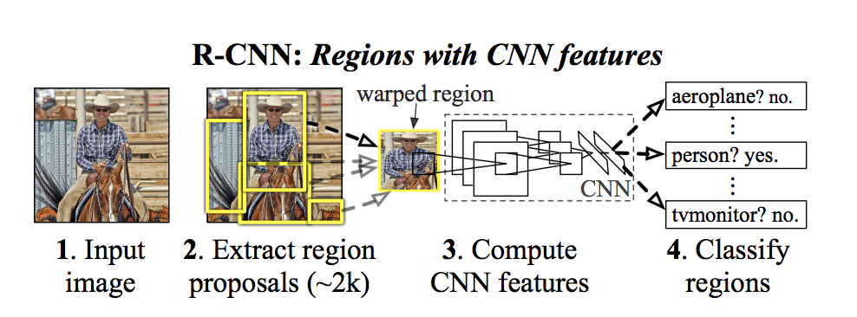
R-CNN Region-based Convolutional Network, 2014
Idea:
Use an algorithm (or network) to find region of interests (ROIs) that are likely to contain an object
Localize (label + bounding box) localize the object in each in region
https://arxiv.org/pdf/1311.2524.pdf

Slide 57
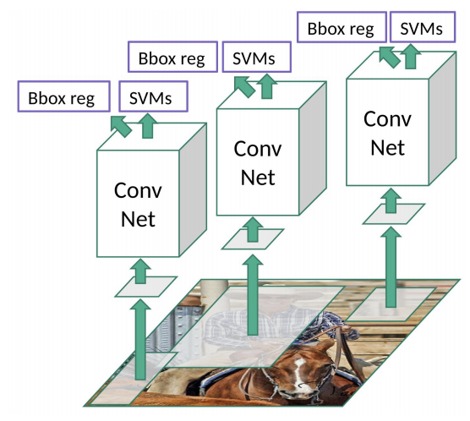
R-CNN Region-based Convolutional Network, 2014
Selective search to extract 2000 regions. NO learning here
Image source: https://towardsdatascience.com/r-cnn-fast-r-cnn-faster-r-cnn-yolo-object-detection-algorithms-36d53571365e

Slide 58
R-CNN Region-based Convolutional Network, 2014
Warp each image region into a square of 227x227 ROI (will be fed to AlexNet)
Selective search to extract 2000 regions. NO learning here
Image source: https://towardsdatascience.com/r-cnn-fast-r-cnn-faster-r-cnn-yolo-object-detection-algorithms-36d53571365e

Slide 59
R-CNN Region-based Convolutional Network, 2014
AlexNet – feature extractor
Warp each image region into a square of 227x227 ROI (will be fed to AlexNet)
Selective search to extract 2000 regions. NO learning here
Image source: https://towardsdatascience.com/r-cnn-fast-r-cnn-faster-r-cnn-yolo-object-detection-algorithms-36d53571365e

Slide 60
R-CNN Region-based Convolutional Network, 2014
SVMs to classify the presence + label of an object in region
Regression to fine tune the bounding boxes
AlexNet – feature extractor
Warp each image region into a square of 227x227 ROI (will be fed to AlexNet)
Selective search to extract 2000 regions. NO learning here
Image source: https://towardsdatascience.com/r-cnn-fast-r-cnn-faster-r-cnn-yolo-object-detection-algorithms-36d53571365e

Slide 61
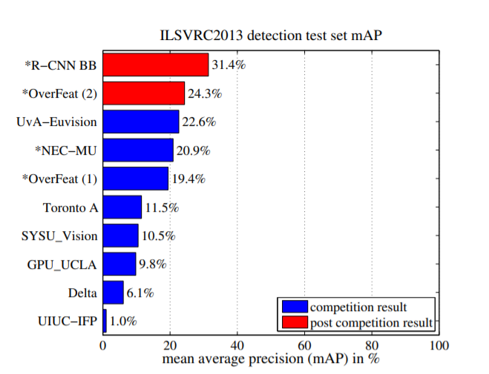
R-CNN
Running time: “13s/image on a GPU or 53s/image on a CPU”

Slide 62
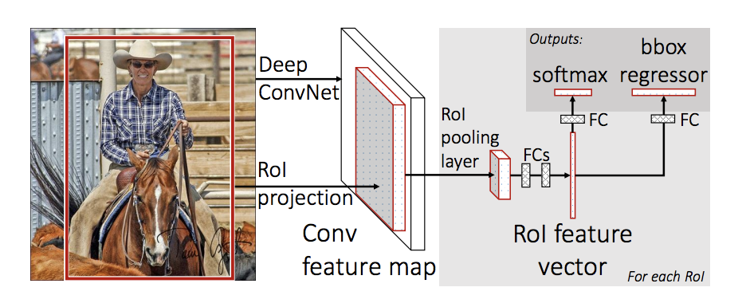
Fast RCNN
Idea: feed to image only once to the CNN to extract a feature map, then crop and warp regions of this feature map

Slide 63
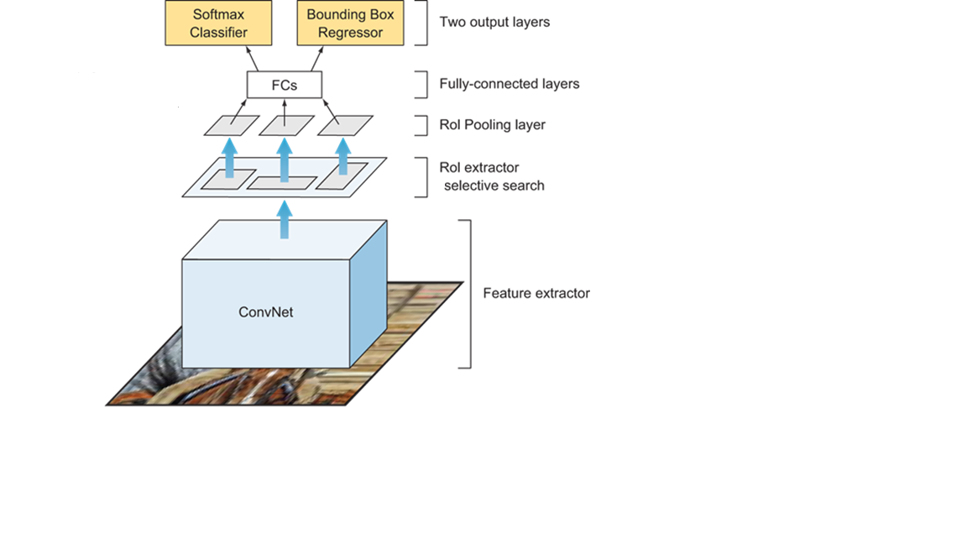
Fast R-CNN
Feed the ENTIRE image only once though the CONV net

Slide 64
Fast R-CNN
Extract the ROIs (proposed by selective search) at feature map level using RoI Pooling

Slide 65
Fast R-CNN
N classes + background
Bounding boxes
(x, y, w, h)
Extract the ROIs (proposed by selective search) at feature map level using RoI Pooling
Feed the ENTIRE image only once though the CONV net

Slide 66
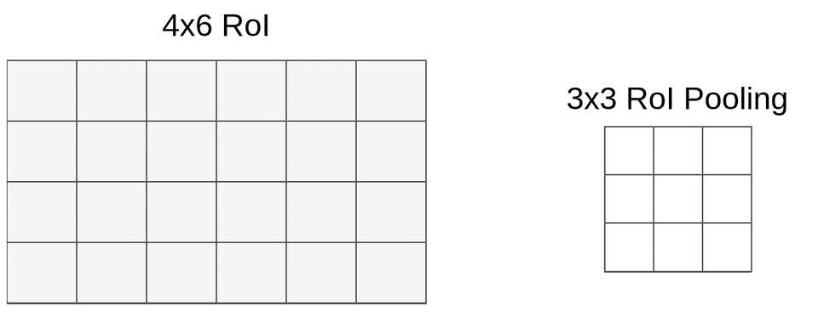
Roi Pooling
Divide the H × W ROI window into an h × w grid of sub-windows of approximate size H/h × W/w and then max-pooling the values in each sub-window into the corresponding output grid cell.

Slide 67
Roi Pooling
W = 6, H = 4
w = 3, h = 3
sz_w = 6/3=2, sz_h=4/3 = 1

Slide 68
Roi Pooling
W = 6, H = 4
w = 3, h = 3
sz_w = 6/3=2, sz_h=4/3 = 1
Apply max pooling in each ROI

Slide 69
Roi Pooling
W = 6, H = 4
w = 3, h = 3
sz_w = 6/3=2, sz_h=4/3 = 1
Apply max pooling in each ROI

Slide 70
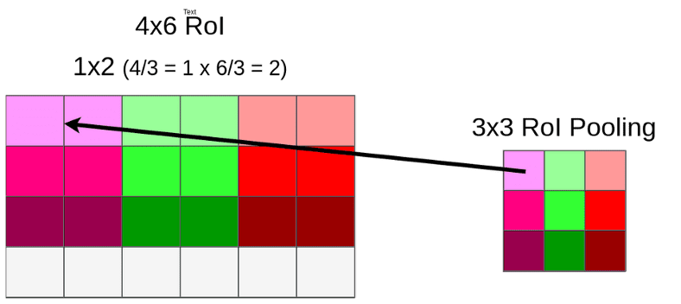
ROI Pooling example
https://towardsdatascience.com/understanding-region-of-interest-part-2-roi-align-and-roi-warp-f795196fc193
https://towardsdatascience.com/understanding-region-of-interest-part-1-roi-pooling-e4f5dd65bb44

Slide 71
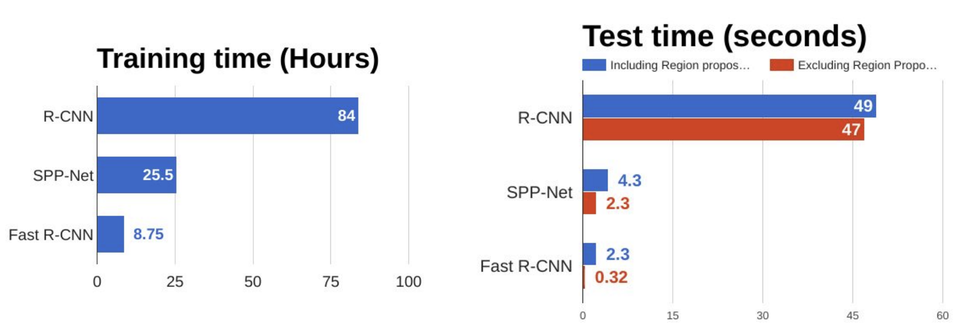
Fast RCNN
What is the most time consuming part of Fast RCNN?

